Slide 1


Chapter 3
Virtual Local Area Networks
(VLANs)
Part I

Slide 2
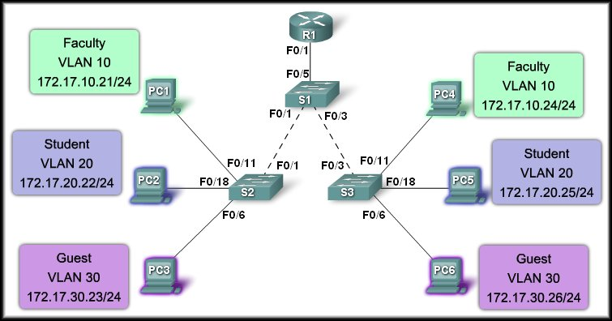
Virtual Local Area Networks
Introducing VLANs

Slide 3
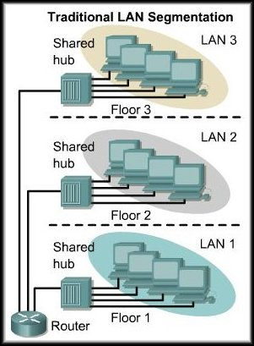
Defining VLANs
Separate Broadcast Domains
In traditional switched LANs, the physical topology is closely related to the logical topology.
Generally, workstations must be grouped by their physical proximity to a switch.
To communicate among LANs, each segment must have a separate port on the backbone device or a connection to a common backbone.

Slide 4
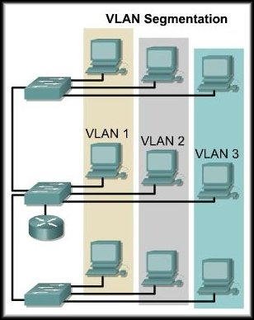
Defining VLANs
Separate Broadcast Domains
VLANs provide segmentation based on broadcast domains.
VLANs logically segment switched networks based on the functions, project teams, or applications of the organization regardless of the physical location or connections to the network.
Communication among VLANs still require a router. BUT, only one physical connection will handle all routing.

Slide 5
Defining VLANs
VLANs are created to provide segmentation services traditionally provided by physical routers in LAN configurations.
  They address:
    Scalability
    Security
    Network Management
    Broadcast Filtering
    Traffic Flow Management
Switches may not forward any traffic between VLANs, as this would violate the integrity of the VLAN broadcast domain.
Traffic must be routed between VLANs.

Slide 6
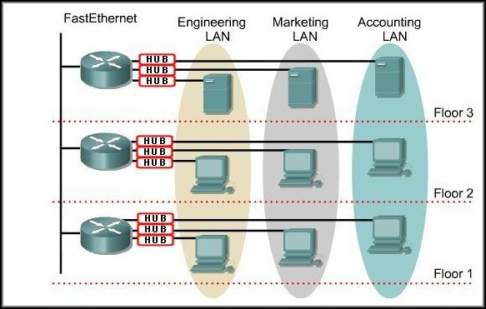
What Does This Mean?
With routers:
Expen$ive!
4 Ports each
3 hubs / floor
10 Broadcast domains
- Inefficient traffic flow
Requirements:
- Different department on
each floor.
- Three different LANs per floor.
- Separate networks

Slide 7
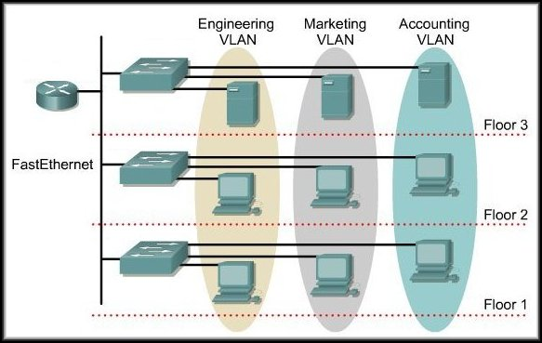
What Does This Mean?
With switches:
More scalable
Easier to manage
1 Router
3 Broadcast Domains
- Efficient traffic flow

Slide 8
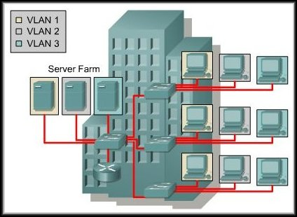
Defining VLANs
A VLAN, then, is a broadcast domain (IP Subnet) created by one or more switches.

Slide 9
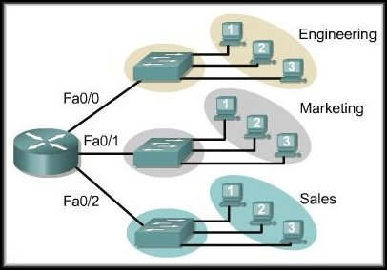
Defining VLANs
The above design shows 3 separate broadcast domains created using one router with 3 ports and 3 switches.
The router filters the broadcasts for each LAN.

Slide 10
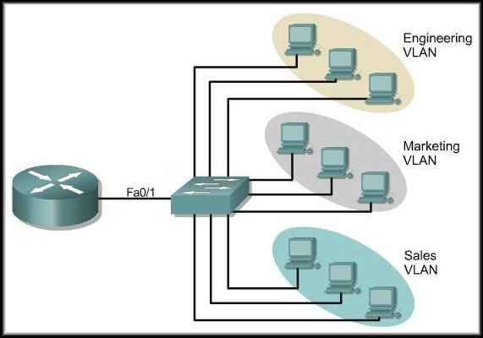
Defining VLANs
One Physical Link
A better design still creates the 3 separate broadcast domains but only requires 1 switch.
The router provides broadcast filtering over a single link.

Slide 11
Defining VLANs
A VLAN allows:
    Creation of groups of logically networked devices.
    The devices to act as if they are on their own independent network.
    The devices can share a common infrastructure.
  Each VLAN is a separate broadcast domain.
    Broadcast traffic is controlled.
  Each VLAN is a separate IP subnet.
    To communicate among VLANs, you must use a router (MUCH more later).

Slide 12
Benefits of VLANs
Security:
  Groups with specific security needs are isolated from the rest of the network.
Cost Reduction:
  Need for expensive hardware upgrades is reduced.
  Better use of existing bandwidth and links.
Higher Performance:
  Dividing large, flat Layer 2 networks into separate broadcast domains reduces unnecessary traffic on each new subnet.

Slide 13
Benefits of VLANs
Broadcast Storm Mitigation:
  Dividing a network into VLANs prevents a broadcast storm from propagating to the whole network.
Improved IT Staff Efficiency:
  Easier to manage the network because users with similar network requirements share the same VLAN.
Simpler Project or Application Management:
  Having separate functions makes working with a specialized application easier. For example, an
  e-learning development platform for faculty.

Slide 14
VLAN ID Ranges
When configured, the number that is assigned to the VLAN becomes the VLAN ID.
The numbers to be assigned are divided into two different ranges:
  Normal Range: 1 – 1005
  Extended Range: 1006 - 4096
Each range has its own characteristics.

Slide 15
VLAN ID Ranges
Normal Range: 1 – 1005
  Used in small- and medium-sized business and enterprise networks.
  IDs 1002 – 1005: Token Ring and FDDI VLANs.
  IDs 1 and 1002 to 1005 are automatically created and cannot be removed.
  Configurations are stored within a VLAN database file, called vlan.dat, located in the flash memory of the switch.
  The VLAN Trunking Protocol (VTP), which helps manage VLAN configurations between switches, can only learn normal range VLANs and stores them in the VLAN database file. (Chapter 4)

Slide 16
VLAN ID Ranges
Extended Range: 1006 – 4096
  Enable service providers to extend their infrastructure to a greater number of customers.
  Some global enterprises could be large enough to need extended range VLAN IDs.
  Support fewer VLAN features than normal range VLANs.
  Are saved in the running configuration file – not the vlan.dat file.
  VTP does not learn extended range VLANs.

Slide 17
Types of VLANs
Traditionally, two methods of implementing VLANs:
  Static or Port-Based:
    Ports on a switch are assigned to a specific VLAN.
  Dynamic:
    VLANs created by accessing a Network Management server. The MAC address/VLAN ID mapping is set up by the Network Administrator and the server assigns a VLAN ID when the device contacts it.
Today, there is essentially one method of implementing VLANs: Port-Based.

Slide 18
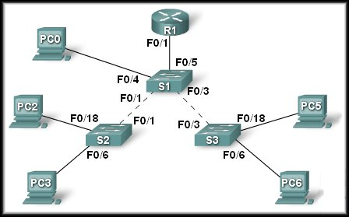
Types of Port-Based VLANs
Defined by the type of traffic they support or by the functions they perform.
  Data VLAN.
  Default VLAN.
  Native VLAN.
  Management VLAN.
  Voice VLAN.

Slide 19
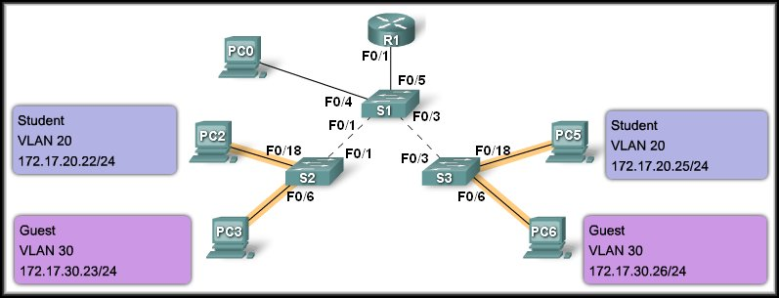
Types of Port-Based VLANs
Data VLAN:
  Configured to carry only user-generated traffic.
  A switch could carry voice-based traffic or traffic used to manage the switch, but this traffic would not be part of a data VLAN.
  A Data VLAN is sometimes referred to as a User VLAN.

Slide 20
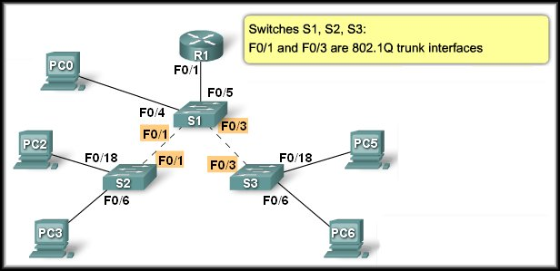
Types of Port-Based VLANs
Default VLAN:
  The default VLAN for Cisco switches is VLAN 1.
  VLAN 1 has all the features of any VLAN, except that you cannot rename it and you can not delete it.
  By default, Layer 2 control traffic (CDP and STP) is associated with VLAN 1.
  It is a security best practice to change the default VLAN to a VLAN other than VLAN 1 (e.g. VLAN 99).
  VLAN Trunk:
    Carries data or control information (VLAN 1 data) for all VLANs from switch-to-switch or switch-to-router.

Slide 21
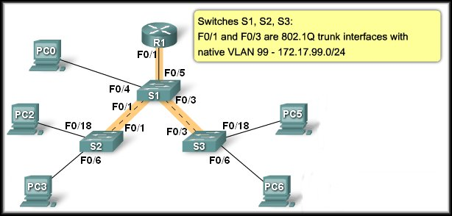
Types of Port-Based VLANs
Native VLAN:
  An 802.1Q trunk port supports traffic coming from VLANs (tagged traffic) as well as traffic that does not come from a VLAN (untagged traffic).
  The 802.1Q trunk port places untagged traffic on the native VLAN.
    Native VLANs are set out in the IEEE 802.1Q specification to maintain backward compatibility with untagged traffic common to legacy LAN scenarios.
  It is a best practice to use a VLAN other than VLAN 1 as the native VLAN.

Slide 22
Remember!
A NATIVE VLAN IS THE UNTAGGED VLAN ON AN 802.1Q
TRUNKED SWITCHPORT. THE NATIVE VLAN AND MANAGEMENT VLAN COULD BE THE SAME, BUT IT IS BETTER SECURITY PRACTICE THAT THEY AREN'T

Slide 23
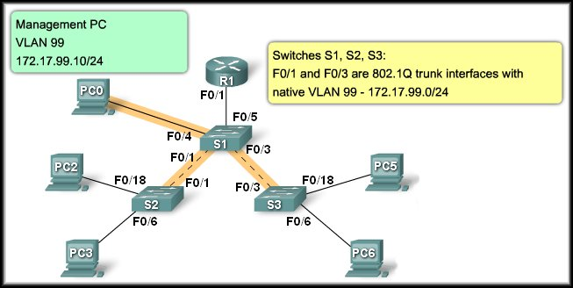
Types of Port-Based VLANs
Management VLAN:
  A management VLAN is any VLAN you configure to access the management capabilities of a switch.
  You assign the management VLAN an IP address and subnet mask.
  A new switch has all ports assigned to VLAN 1.
  Using VLAN 1 as the management VLAN means that anyone connecting to the switch will be in the management VLAN.
    That assumes that all ports have not been assigned to another VLAN.

Slide 24
Types of Port-Based VLANs
Voice VLANs:
  Voice-over-IP (VoIP) traffic requires:
    Assured bandwidth to ensure voice quality.
    Transmission priority over other types of network traffic.
    Ability to be routed around congested areas on the network.
    Delay of less than 150 milliseconds (ms) across the network.
  The details of how to configure a network to support VoIP are beyond the scope of the course, but it is useful to summarize how a voice VLAN works between a switch, a Cisco IP phone, and a computer.

Slide 25
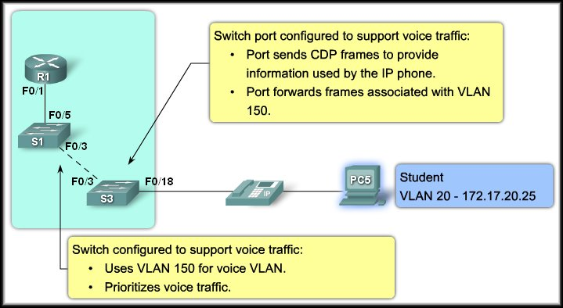
Types of Port-Based VLANs
VLAN 150 is designed to carry voice traffic.
Voice VLANs:
Connections

Slide 26
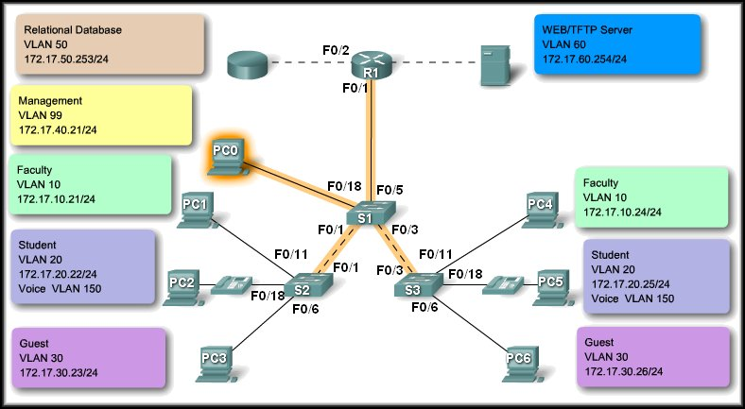
Network Traffic Types
Management Traffic
CDP
SNMP
Rmon

Slide 27
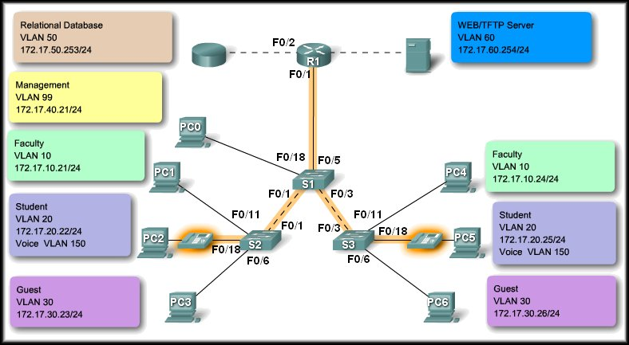
Network Traffic Types
IP Telephony Traffic
Signaling
Data Packets

Slide 28
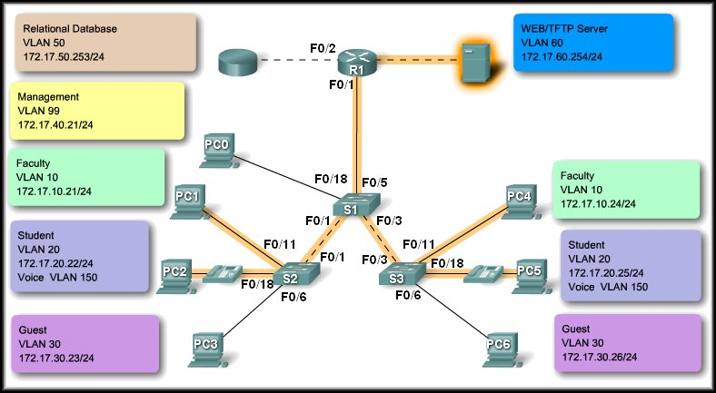
Network Traffic Types
IP Multicast Traffic
VLAN Configuration
Router Configuration
IP/TV Broadcasts
Sent from a particular source address to a multicast group that is identified by a single IP and MAC destination-group address pair.

Slide 29

Network Traffic Types
Normal Data Traffic
File Sharing
Printing
Database Access
Email
Shared Applications

Slide 30
Switch Port Membership Modes
Switch Ports:
  Layer 2-only interfaces associated with a physical port.
  Used for managing the physical interface and associated Layer 2 protocols.
  Do not handle routing or bridging.
  Can belong to one or more VLANs.
Configuring VLANs:
  Must assign a VLAN number.
  Can configure a port specifying:
    The type of traffic.
    The VLANs to which it belongs.

Slide 31
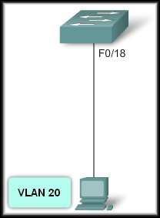
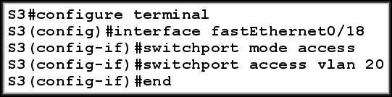
Switch Port Membership Modes
Static VLAN:
  Ports on a switch are manually assigned to a VLAN.
  Static VLANs are configured using the Cisco CLI or a GUI Management application (e.g. Cisco Network Assistant).

Slide 32
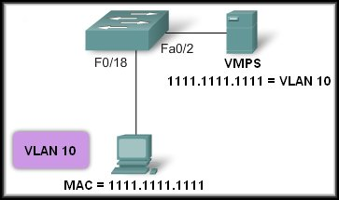
Switch Port Membership Modes
Dynamic VLAN:
  Configured using a special server called a VLAN Membership Policy Server (VMPS).
  Assign switch ports to VLANs based on the source MAC address of the device connected to the port.
  Benefit is that moving
  a user to a different
  port on a switch or to
  a new switch, the
  user is assigned to
  the proper VLAN
  dynamically.
  Not widely used.

Slide 33
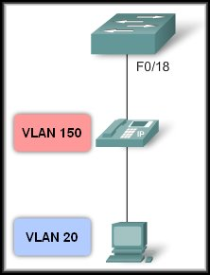
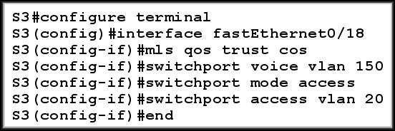
Switch Port Membership Modes
Voice VLAN:
  A port is configured to be in voice mode so that it can support an IP phone.
  Before you configure a voice VLAN on the port, you first configure a VLAN for voice and a VLAN for data.

Slide 34
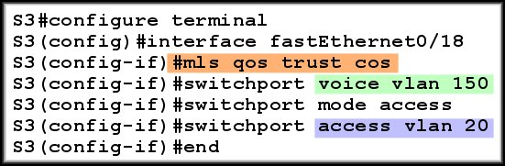
Switch Port Membership Modes
Voice VLAN:
Ensures that voice traffic is identified as priority traffic.
Voice VLAN
Data VLAN
Remember that the entire network must be set up to prioritize voice traffic. You cannot just configure the switch port.

Slide 35
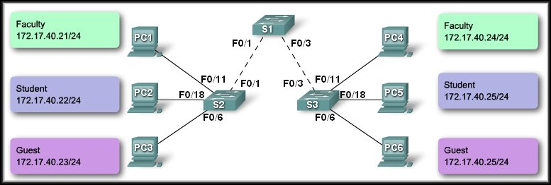
Controlling Broadcast Domains with VLANs
Network without VLANs:
Sends a Broadcast

Slide 36
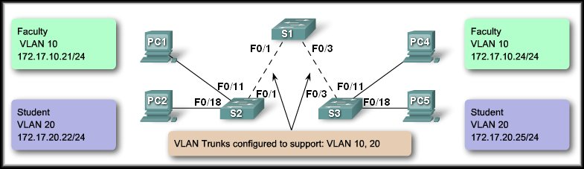
Controlling Broadcast Domains with VLANs
Network with VLANs:
Sends a Broadcast
Sends a Broadcast

Slide 37

Layer 3 Switch Forwarding
Layer 3 Switch:
  A Layer 3 switch has the ability to route transmissions between VLANs.
  The procedure is the same as described for the inter-VLAN communication using a separate router.
Switch Virtual interface (SVI):
  A logical interface (SVI) is configured for each VLAN configured on the switch.

Slide 38
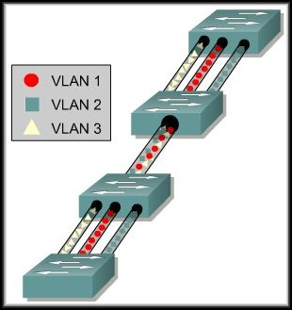
Virtual Local Area Networks
VLAN Trunking

Slide 39
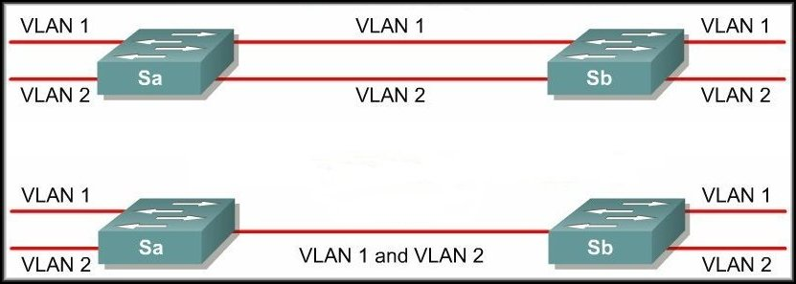
VLAN Trunking
No trunk
Trunk
The same principle of trunking is applied to network switching technologies.
A trunk is a physical and logical connection between two switches across which network traffic travels.

Slide 40
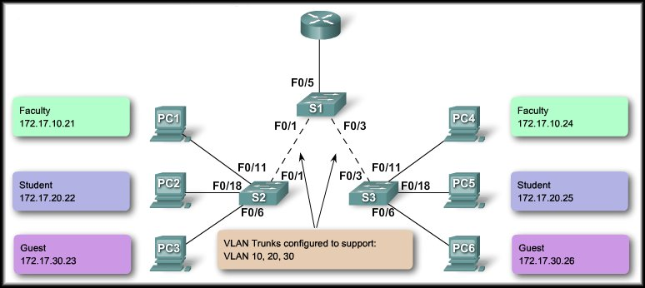
Trunking Operation
The tagged frames are sent across the trunk links between S2 and S1 and S1 and S3.
PC1 and PC3
send a broadcast.
10
10
20
20
30
30
S3 strips the tags and forwards to the destination.
S2 receives the frames and ‘tags’ them with the VLAN ID.

Slide 41
Trunking Modes
A Cisco switch can be configured to support two types of trunk ports:
  IEEE 802.1Q
  ISL (Inter-Switch Link)
Today only 802.1Q is used.
Legacy networks may still use ISL.

Slide 42
Virtual Local Area Networks
Configure VLANs and Trunks

Slide 43
Configure VLANs and Trunks
Overview:
  Create the VLANs.
  Assign switch ports to VLANs statically.
  Verify VLAN configuration.
  Enable trunking on the inter-switch connections.
  Verify trunk configuration.

Slide 44
Configure a VLAN
Command Syntax:
  S1#configure terminal
  S1(config)#vlan vlan id
  S1(config-vlan)#name vlan name
  S1(config-vlan)#end

Slide 45
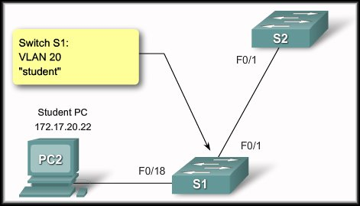
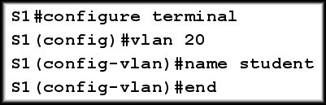
Configure a VLAN
Configure a VLAN

Slide 46
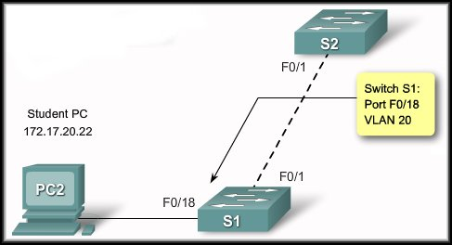
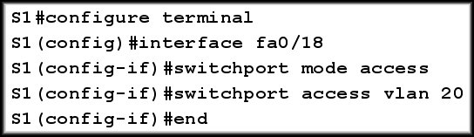
Configure a VLAN
Assign switch ports to a VLAN

Slide 47
Configure a Trunk
Command Syntax:
  S1#configure terminal
  S1(config)#interface interface-id
  S1(config-if)#switchport mode trunk
  S1(config-if)#switchport trunk native vlan vlan-id
  S1(config-if)#switchport trunk allowed vlan add vlan-list
  S1(config-vlan)#end

Slide 48
Configure a Trunk
Command Syntax:
  S1#configure terminal
  S1(config)#interface interface-id
  S1(config-if)#switchport mode trunk
  S1(config-if)#switchport trunk native vlan vlan-id
  S1(config-if)#switchport trunk allowed vlan add vlan-list
  S1(config-vlan)#end

Slide 49
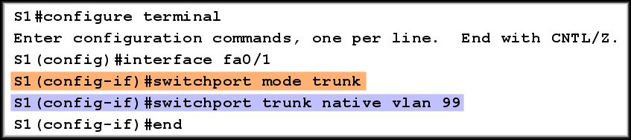
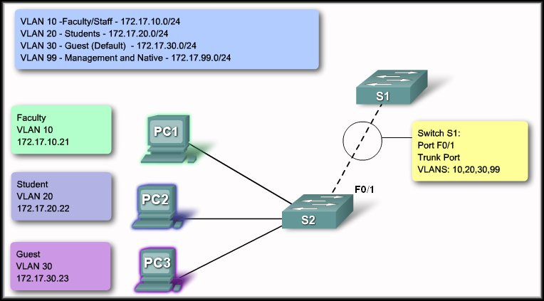
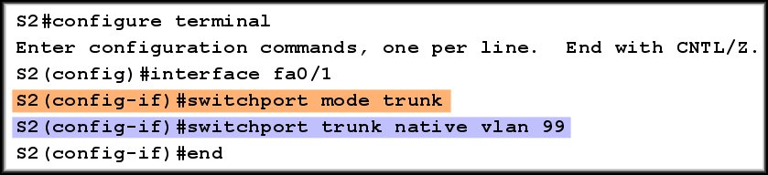
Configure a Trunk

Slide 50
Configure a Trunk
The native VLAN must match on both switches.

